Slide 1





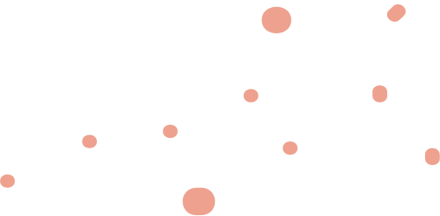
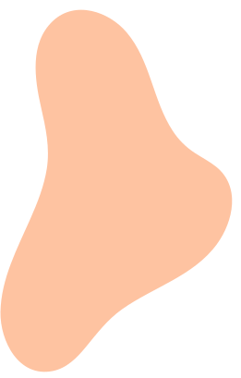


Exploratory Data Analysis tool application

Slide 2
Tech stack used
1.
2.
Python Programming Language
Pandas Library
3.
Other Python Libraries such as Autoviz,Plotly,Scipy etc.
4.
Streamlit

Slide 3

Introduction
This Exploratory Data Analysis (EDA) Tool is designed to assist users and data analysts in understanding their datasets through a comprehensive and interactive interface .This is designed using Streamlit, Python , Pandas and Autoviz.

Slide 4
ITS Functionality
This tool provides functionality for users to upload their datasets and perform basic data quality checks such as identifying any special characters in column names ,check and fill missing values ,detecting outliers and finding duplicate rows.
It also enables users to conduct:
Data Visualization : Generate various types of plots including histograms,scatter plots ,box plots ,correlation matrix and more.

Slide 5
ITS Functionality
Data Cleaning and Preprocessing : Identify and handle missing values,outliers and duplicates and automatically identify and correct special characters in column names
Statistical Summaries : Display summary statistics for numerical and categorical variables.
correlation Analysis : Analyze relationships between different variables using correlation matrices and heatmaps.
Inferential Analysis : Conduct t-tests,F-tests,chi-square tests,shapiro-wilk tests for hypothesis testing.
EDA Report Generation : Automatically generate comprehensive EDA Reports.

Slide 6
How to use this ?
1.
Open the Application and load your dataset(CSV ,Excel)
2.
Explore the Data use the navigation pane t,o conduct Summary statistics , Data Visualization ,Data Cleaning and EDA Report Generation

Slide 7
DEMO VIDEO
CLICK HERE TO CHECK ITS DEMO VIDEO !!

Slide 8
Challenges Faced
Integration of Autoviz Library :
One of the challenges I faced in this project was integrating the Autoviz library to automatically generate EDA reports on a temporary data file rather than a permanent one. This was particularly challenging because Autoviz typically requires a file path to a saved CSV file, not just an in-memory DataFrame. Since we wanted users to upload files temporarily and generate insights on the go, I had to implement ,that would create a temporary file from the uploaded data.

Slide 9
HOW I TACKLED THIS
To tackle this, Firstly I researched about it from google and Chatgpt as well then I Followed those steps ,I saved the uploaded file temporarily using Python’s built-in file handling functions. Once the file was saved, I passed the file path to Autoviz for analysis. After generating the EDA report, I used Matplotlib to capture the visualizations, saved them as temporary image files, and displayed these images in the Streamlit app. Finally, to maintain data security and clean up resources, I removed both the temporary data file and visualization files from the system.
This approach allowed me to efficiently integrate Autoviz with our temporary data flow, ensuring we could generate and display reports seamlessly while handling files securely. It was a valuable learning experience in balancing library requirements with a dynamic application environment.

Slide 10
Challenges Faced
What Elements should be included :
The other challenge was that how to design this EDA tool application what should be included or not .So that it looks well- structured to users and interactive ,also able to show different visualizations .

Slide 11
HOW I TACKLED THIS
To tackle this, Firstly I generated list of the required elements and steps like include badic data quality check functionality such as detecting special characters in columns name , detect ouliers , identify duplicate rows and check and handle missing values etc .
then I considered the important charts like bar plots, histogram , scatter plots and heatmaps like
Apart from this , i included various hypothesis tests like t-test, f-test, chi-square test etc . And at last functionality of Automatic EDA Report generation for Users.

Slide 12
Conclusion
In summary, the EDA Tool App not only simplifies the often time-consuming tasks of data cleaning and EDA but also enhances the accessibility of data analysis processes for users, regardless of their technical background. This project serves as a stepping stone for developing more advanced data analysis platforms and highlights the importance of intuitive, automated data handling in modern data science workflows.

Slide 13
Any Suggestions OR Recommendations ?

Slide 14
Thank You
By -Anshika Tyagi

